Slide 1
DATA ENGINEERING- 2
Customer and Traffic Insights with TLC Data
Team: 5
Disha Gayathri Umashankar
Sandhya Tripathi
Blessy Evangeline
SRH Hochschule Heidelberg

Slide 2

Introduction of the Data Source
Data Source:
The dataset was sourced from the NYC Taxi and Limousine Commission (TLC), which publicly provides detailed trip records for yellow taxis, green taxis, and for-hire vehicles operating in New York City. The yellow taxi trip data includes comprehensive information such as pickup and drop-off dates and times, locations, trip distances, itemized fares, payment types, and passenger counts. This open dataset is updated on a monthly basis, making it a reliable resource for tracking trends over time.
https://www.nyc.gov/site/tlc/about/tlc-trip-record-data.page

Slide 3
Motivation from Application Perspective
Traffic Management and Congestion Analysis
Ride-Hailing Optimization
Urban Planning and Policy Development
Economic and Behavioral Insights
Predictive Modeling

Slide 4
Overview of TLC Dataset
Dataset contains 100,000 records and 19 features a total of 15 MB, representing detailed information
about New York Yellow taxi trips for the year 2024. It is optimized for analysis of fare amounts,
trip distances, locations, and payment details
Key Attributes:
Trip Details: VendorID, tpep_pickup_datetime, tpep_dropoff_datetime, trip_distance
Passenger Info: passenger_count
Geolocation: pickup_longitude, pickup_latitude, dropoff_longitude, dropoff_latitude
Rates and Payments: fare_amount, tip_amount, payment_type, tolls_amount, total_amount

Slide 5
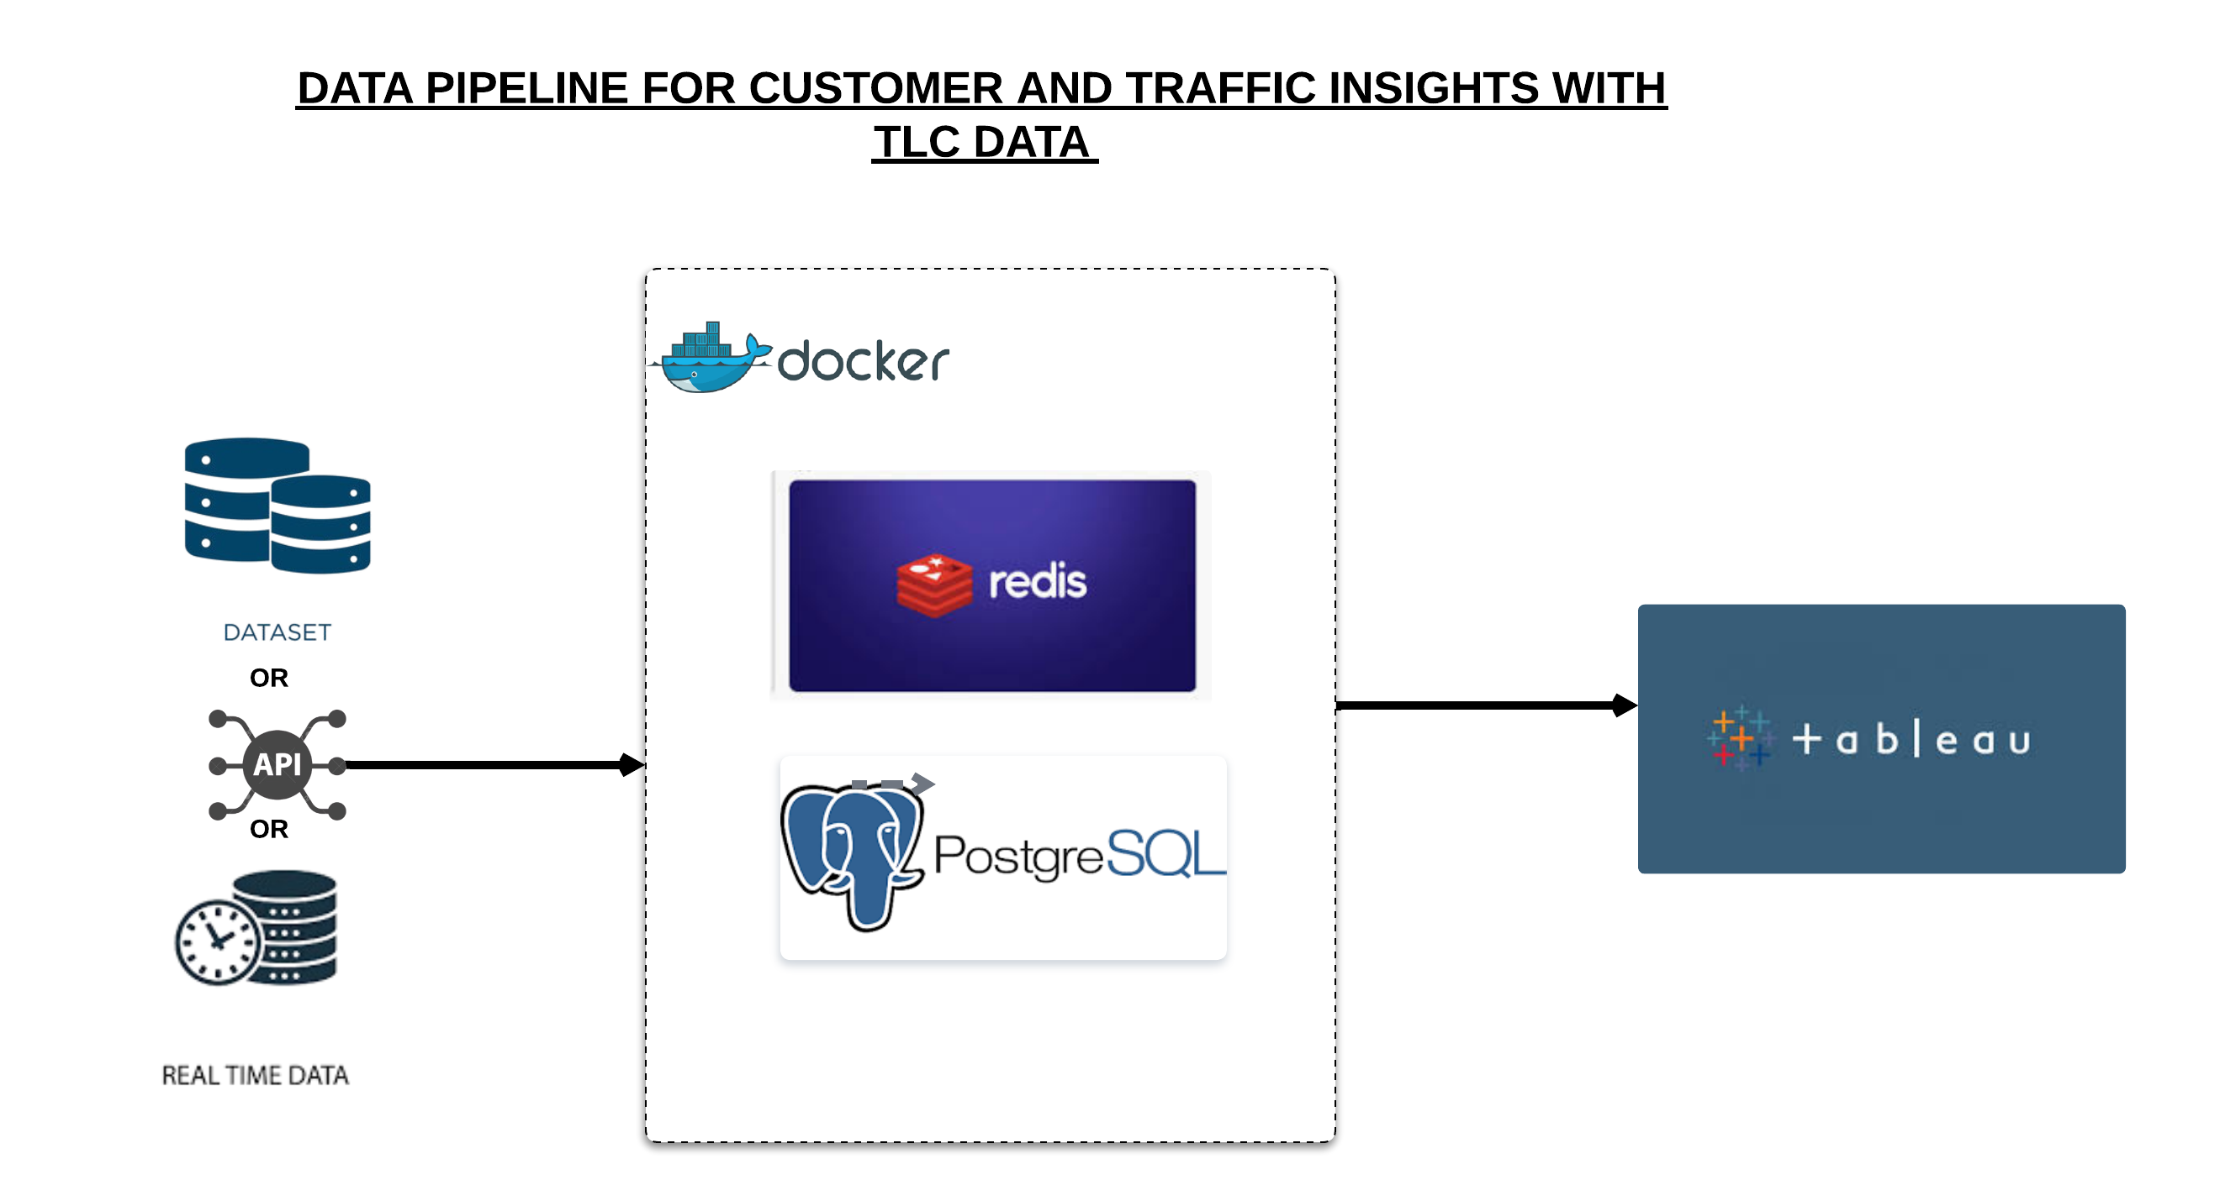
Overview of the Data Pipeline
Components of the Pipeline:
Docker: Used to containerize the ETL pipeline for modularity and portability.
Redis: For in-memory caching to improve data transformation speed.
Postgres: To store the structured and normalized data.
Tableau: For visualizing the insights and analytics.

Slide 6
Specific Configurations
Docker Desktop (version 4.31.1) Docker Engine (version 26.1.4)
Redis (version 7.4.1)
Python (version 3.13.1)
Visual Studio (version 1.96.0 )
PostgreSQL (version 17.2 ) Debian (version 17.2.1)
Tableau Desktop (version 4.37.0)

Slide 7
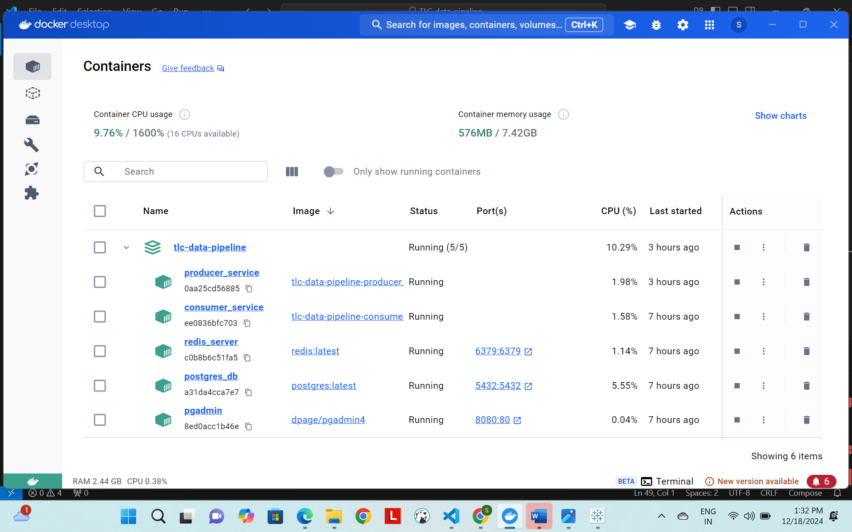

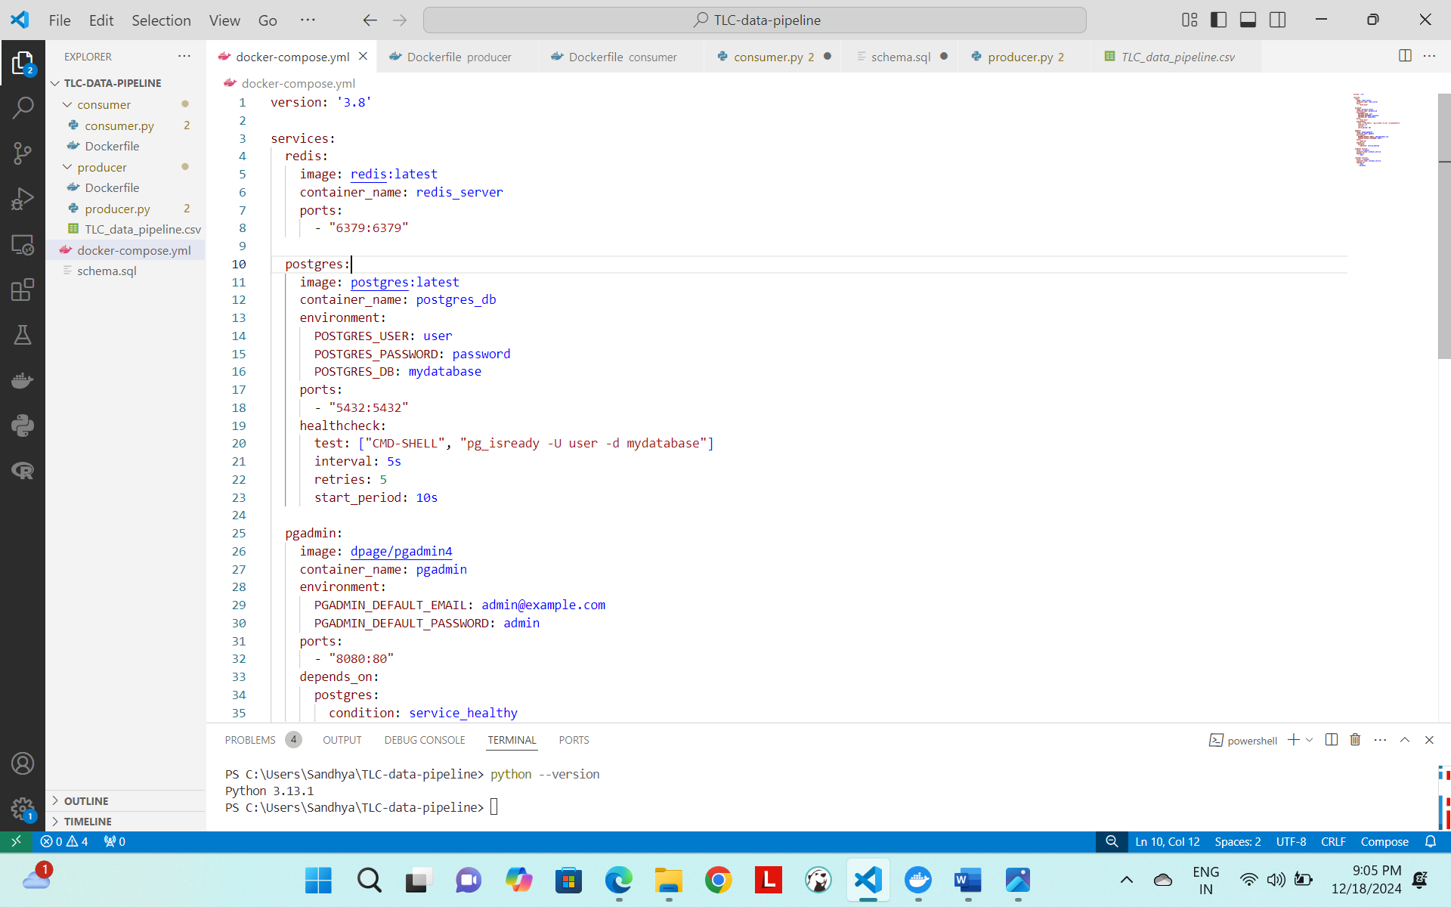
Status of Containers inside Docker

Slide 8
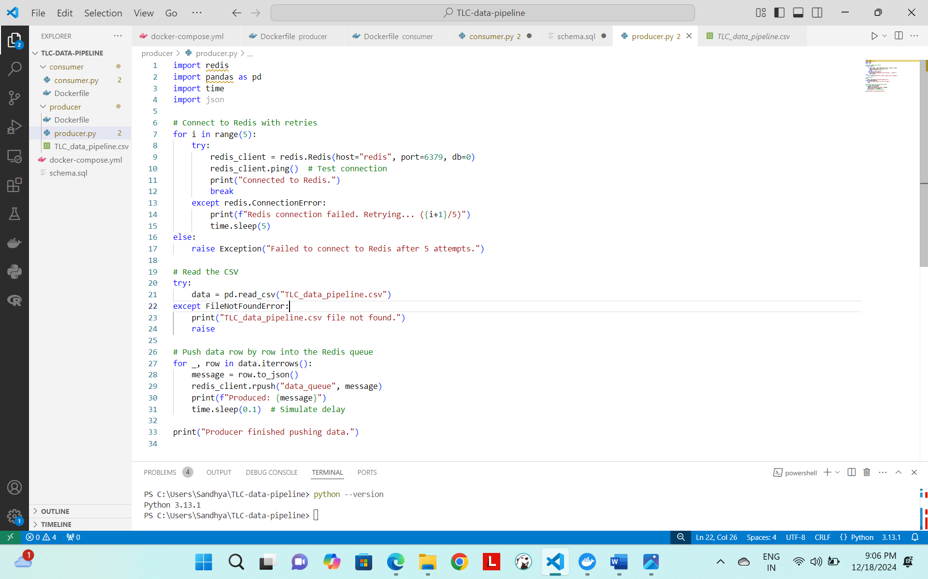
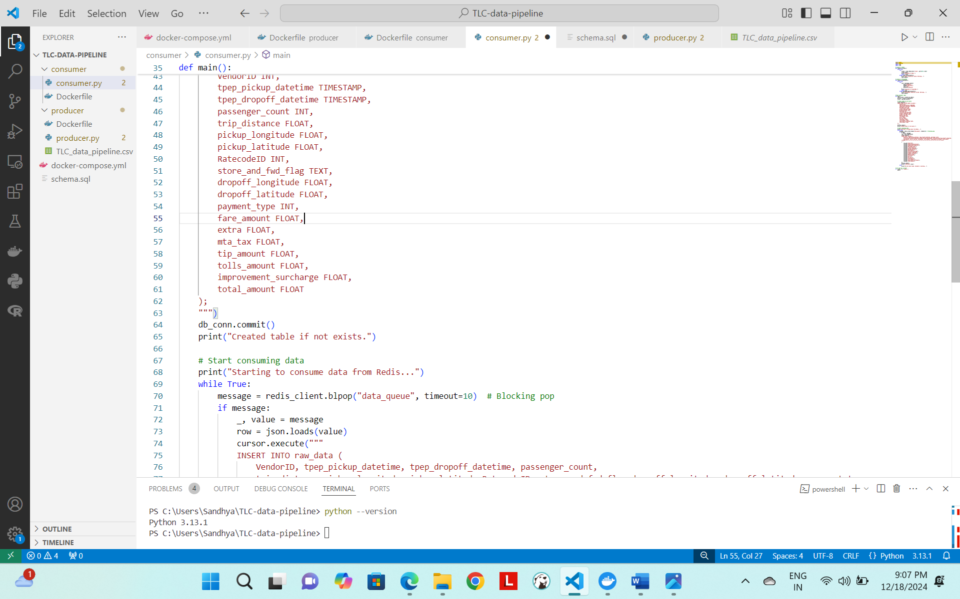
Producer and Consumer

Slide 9
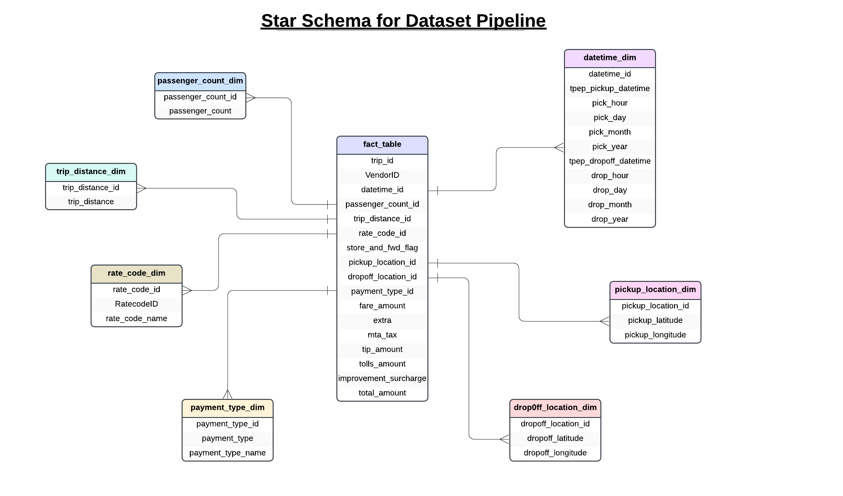

Slide 10
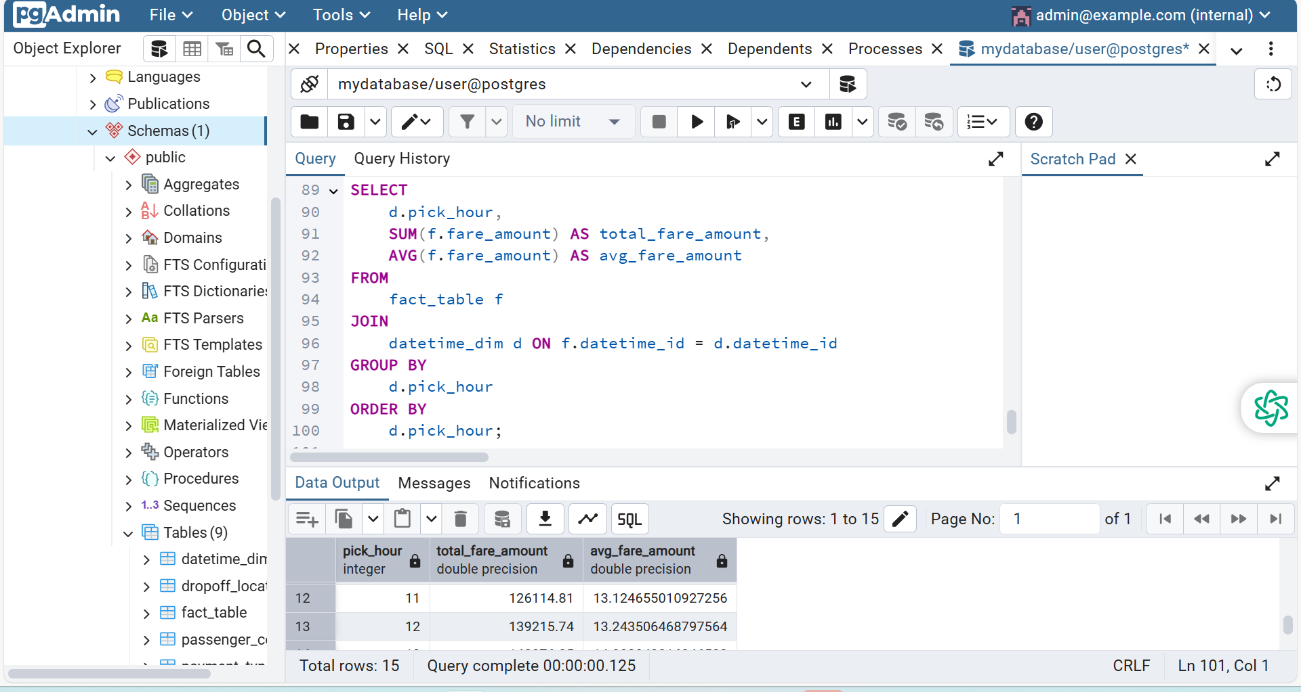
Output Query 1 on Postgres Admin Server

Slide 11
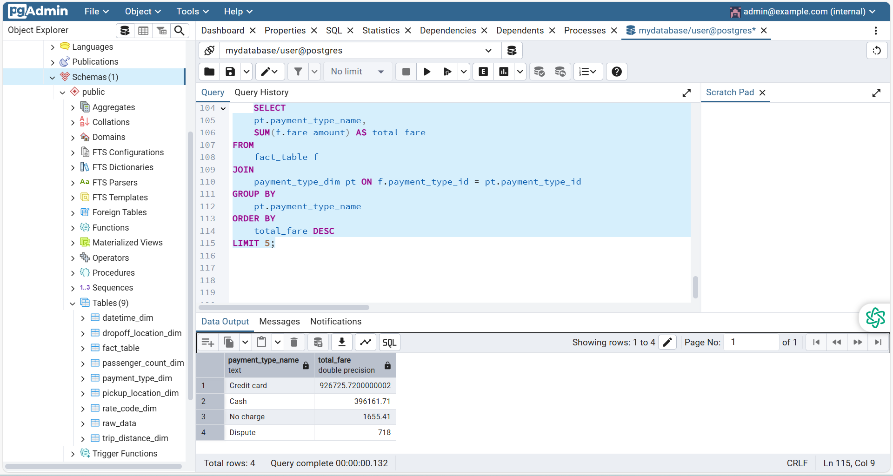
Output Query 2 on Postgres Admin Server

Slide 12
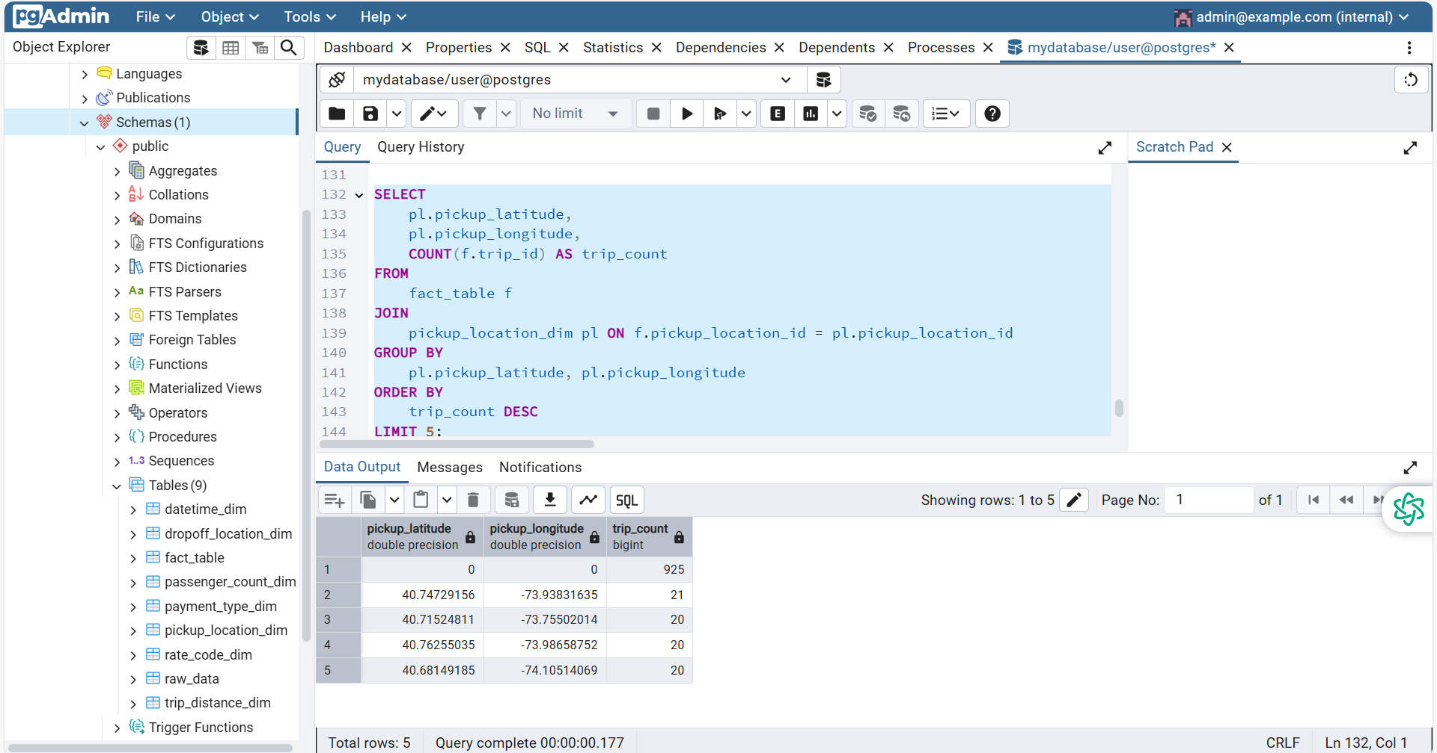
Output Query 3 on Postgres Admin Server

Slide 13
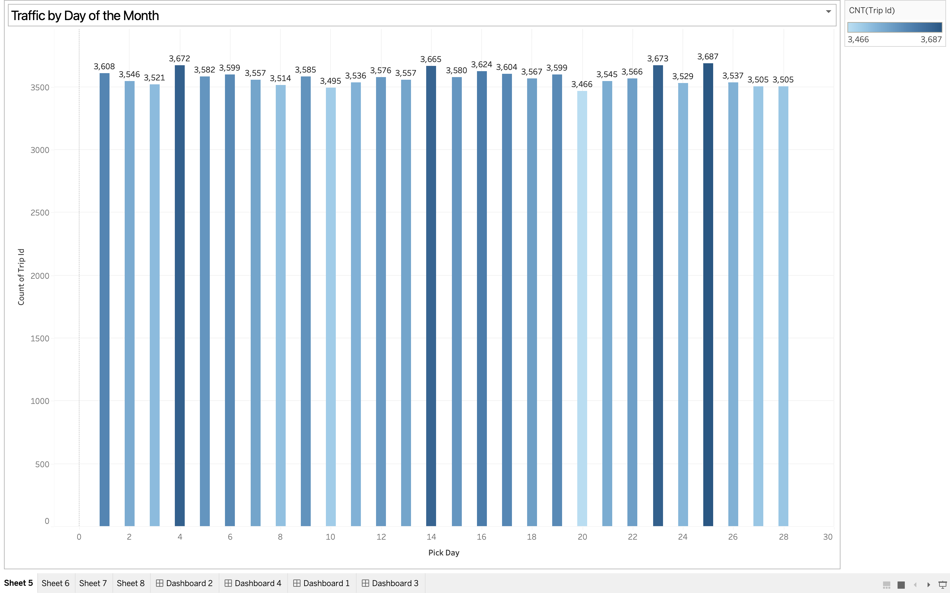
Visualization

Slide 14
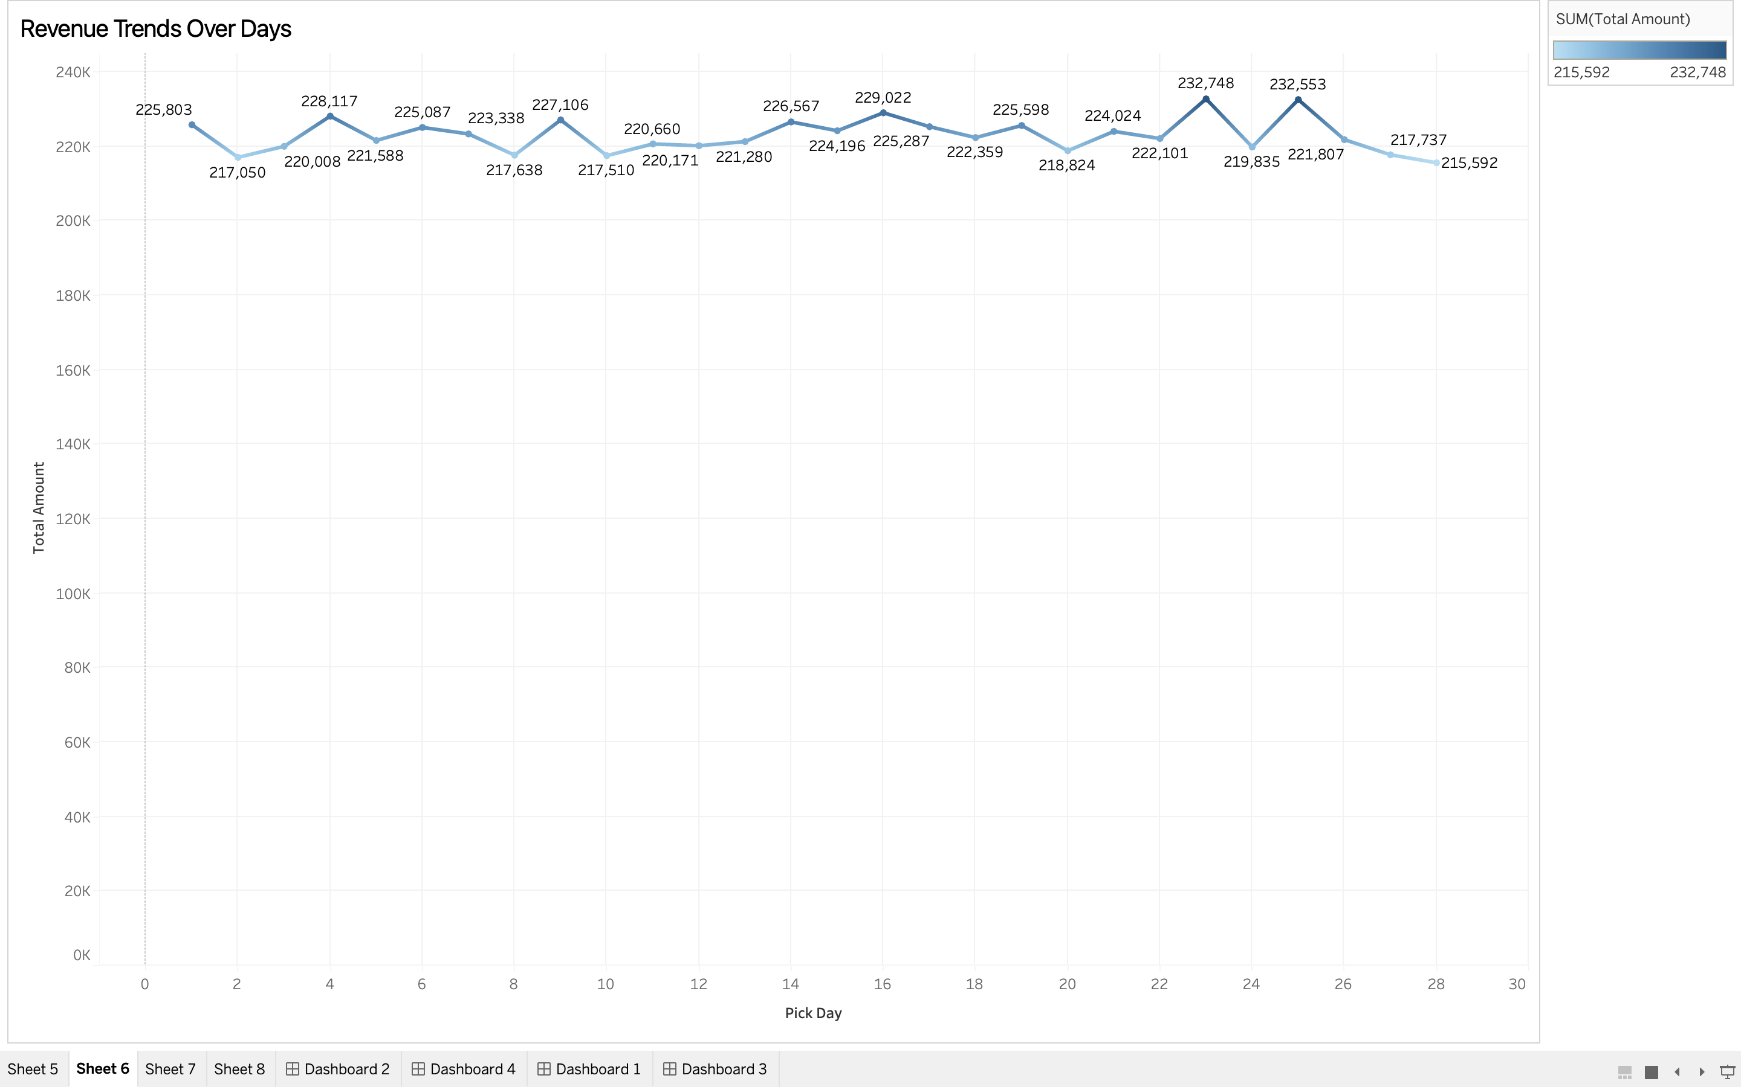
Visualization

Slide 15
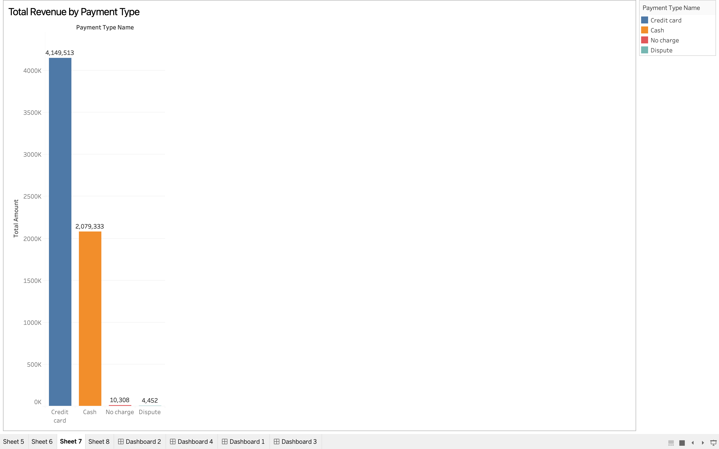
Visualization

Slide 16
Challenges and Solutions
Challenge 1: Handling Large Data with poor Network Integrating Kafka with Apache Airflow and Debezium proved difficult, as Kafka topics were not being created successfully. Additionally, setting up Mage workflows on Google Cloud Platform (GCP) was challenging due to the difficulty of loading 15MB of data.
Solution: To overcome these challenges, we replaced Kafka with Redis as the message broker, which provided a simpler and more reliable solution.
Challenge 2: Docker Network Configuration Configuring Redis and Postgres within Docker containers to communicate seamlessly was tricky.
Solution: We resolved this by defining proper networks and environment variables in Docker Compose.

Slide 17
Summary
Our pipeline successfully integrates data extraction, transformation, and storage. While results are still being refined, we built a functional prototype capable of analysing and visualizing transportation trends
Future Work:
Expand the visualizations to include advanced Tableau dashboards
Scale the solution for larger datasets using cloud infrastructure

Slide 18
Bibliography
https://www.nyc.gov/site/tlc/about/tlc-trip-record-data.page
https://github.com/
https://www.lucidchart.com/
https://www.youtube.com/
[1] Big Data Analytics of Taxi Operations in New York City Author: Y. Tang, American Journal of Operations Research, 2019
[2] A Study of More Than One Billion Taxi Trips in New York City Authors: D. Zhao, K. Musolesi, Scientific Reports, 2020
[3] Big Data Driven Model for New York Taxi Trips Analysis Authors: S. A. Mostafa, M. M. Hamdan, M. A. Alsmirat, IEEE Access, 2021
[4] Spatiotemporal Analysis of Ridesourcing and Taxi Demand by Taxi Zones in New York City Authors: P. Toman, J. Zhang, N. Ravishanker, K. Konduri, arXiv preprint, 2020

Slide 19




Kontakt:
Max Mustermann
SRH Holding (SdbR)
Bonhoefferstraße 1
69123 Heidelberg
T +49 6221 8223-0
info@srh.de
www.srh.de

